Slide 1


REAL-TIME HAND GESTURE-CONTROLLED ROBOTIC ARM USING COMPUTER VISION
By D04,
Geshna B (CB.SC.U4AIE23360)
Katikala Dedeepya (CB.SC.U4AIE23349)
Malavika S Prasad (CB.SC.U4AIE23315)
Vada Gouri Hansika Reddy (CB.SC.U4AIE23304)

Slide 2
INTRODUCTION
The project aims to revolutionize assistive technology by designing a robotic arm that can accurately replicate gestures shown on a screen.
Technology Integration: Combines OpenCV for advanced gesture recognition, CVZone for precise hand detection, and Arduino-controlled servo motors for lifelike finger articulation.
Features a high-speed communication interface between the vision system (PC) and robotic arm (Arduino), enabling instantaneous replication of complex gestures.

Slide 3
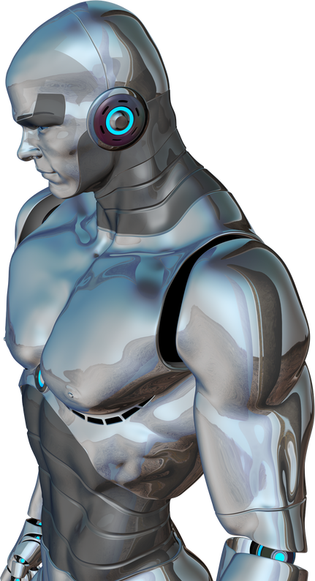
OBJECTIVES :
Design and develop a robotic arm that can accurately replicate gestures based on visual input from a camera.
Implement AI-based gesture recognition using OpenCV and CVZone for precise sign detection.
Ensure real-time processing for immediate gesture-to-action conversion with minimal latency.
Optimize servo motor control using PID algorithms to achieve smooth and natural finger movements.
Create a user-friendly system for educational, assistive, and communication technologies, promoting inclusivity.

Slide 4
Title | Summary | Challenges faced
OpenCV-Based Object Tracking (MDPI, 2021) | Explores the use of OpenCV for object tracking, detailing methods for improving tracking consistency. | Difficulty in accurately tracking fast-moving objects.
AI in Robotic Vision Systems (Springer, 2021) | Examines AI applications in robotic vision, highlighting deep learning models for complex recognition tasks. | Requirement of large training datasets to achieve model accuracy.
Servo Motor Control for Robotics (IEEE, 2019) | Analyzes servo motor technologies, including control algorithms for enhancing robotic arm precision. | Mechanical backlash and limited precision in motor control.
Robotic arms in precision agriculture | the role of robotic arms in precision agriculture, focusing on technologies, applications, challenges, and future prospects for enhancing efficiency, sustainability, and automation through AI integration. | the role of robotic arms in precision agriculture, focusing on technologies, applications, challenges, and future prospects for enhancing efficiency, sustainability, and automation through AI integration.
Embedded Systems in AI Robotics (MDPI, 2023) | the integration of AI in embedded systems, emphasizing the enhancement of machine learning and deep learning techniques in robotics, smart devices, and IoT | Hardware constraints restricting algorithm efficiency

Slide 5
Title | Summary | Challenges faced
Internet Controlled Robotic Arm (Wan Muhamad Hanif Wan Kadir) | an internet-controlled robotic arm system that enables remote manipulation using a web interface and microcontroller communication for various applications. | latency issues in internet-based control,Remote access poses high risk of unauthorized control.
Industrial Automation Using Vision Systems(Mohd Javaid, Abid Haleem, Ravi Pratap Singh) | The paper presents an AI-powered robotic arm using computer vision for real-time object detection, tracking, and manipulation, with applications in automation and industry. | High-cost and complexity of integrating AI models
Machine Learning for Grasping Objects(Youhao Li, Qujiang Lei, ChaoPeng Cheng) | the use of machine learning, particularly deep learning models, for object detection and recognition in robotic systems | Difficulty in generalizing grasping strategies across different objects,large dataset.

Slide 6
Title | Summary | Challenges faced
Image edge detection techniques by Badri Narayan Mohapatra(2019) http://dx.doi.org/10.19101/TIPCV.2019.515008 | Explores different edge detection algorithms such as Sobel, Canny, and hybrid techniques, comparing their accuracy and computational efficiency. | Occlusion, illumination variation, background clutter, and real-time processing limitations.
Object Tracking Using Computer Vision: A Review by Pushkar Kadam, Gu Fang and Ju Jia Zou(2024) https://doi.org/10.3390/computers13060136 | Provides an overview of object tracking methods, including feature-based and deep learning approaches, highlighting their effectiveness in real-time applications. | Challenges include sensitivity to noise and the trade-off between edge detection accuracy and computational efficiency.
Gesture-Controlled Robotic Arm Utilizing OpenCV by Jedidiah Paterson and Ahmed Aldabbagh(2021) 10.1109/HORA52670.2021.9461389 | Demonstrates a robotic arm controlled by hand gestures using OpenCV, leveraging contour detection and hand tracking for real-time operation. | Challenges include accurate gesture recognition under varying lighting conditions and ensuring real-time responsiveness.

Slide 7


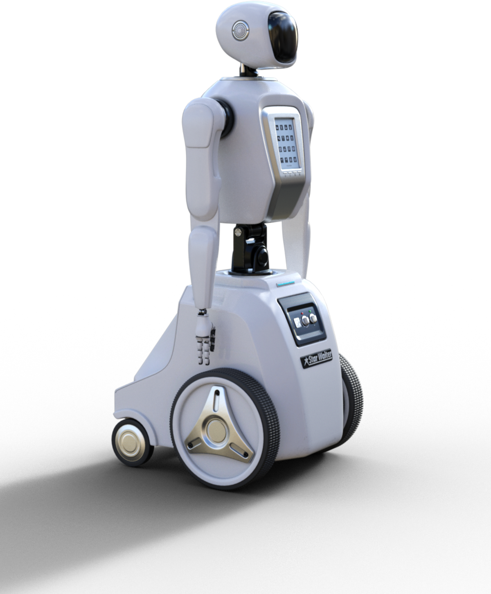
RESEARCH GAP
1
Real-time image processing on Arduino is not feasible
Most papers suggest microcontrollers are not powerful enough for complex vision tasks.
Background noise affects object recognition
Papers highlight that lighting variations and object occlusions reduce recognition accuracy.
Servo motor precision issues
Many studies mention mechanical backlash and limited resolution in servo motors, affecting precise movements.
Processing delay in communication between vision system and robotic arm
Research indicates that delays in serial communication between OpenCV and Arduino reduce efficiency in real-time applications.
2
3
4

Slide 8

PROPOSED METHODS TO ADDRESS RESEARCH GAPS
Offloading Image Processing to a PC
Use OpenCV on a PC for real-time vision tasks, reducing Arduino's computational load.
Send only essential control signals to Arduino.
Enhancing Object Recognition Using Contour Filtering & Edge Detection
Apply HSV thresholding to remove background noise.
Use Canny Edge Detection & Hough Transform for better object segmentation.
Kalman filter - To reduce Occulsion by Predicting Future Positions.
Optimizing Servo Motor Precision Using PID Control
Implement a PID controller for Smooth servo positioning
Minimize overshooting and backlash for smooth positioning
Reducing Communication Delay with a Lightweight Serial Protocol
Use Python’s PySerial for efficient OpenCV-Arduino communication.
Optimize data format to reduce latency.

Slide 9


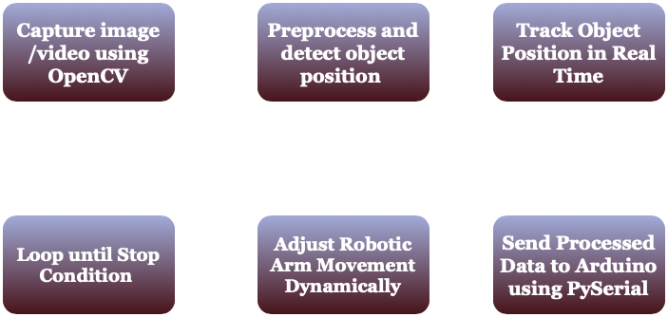
WORKFLOW

Slide 10
Hardware Requirements
Microcontroller: Arduino Uno
Acts as the brain of the robotic arm.
Controls servo motors based on commands from the computer.
Communicates with the PC via USB/UART.
Camera Module: USB Webcam
Captures real-time images for object detection.
Sends frames to the PC for processing using OpenCV.
Resolution & FPS affect detection accuracy.
Servo Motors: MG995 / SG90
MG995 (High Torque, Metal Gear) – For heavy lifting.
SG90 (Lightweight, Plastic Gear) – For small movements.
Controlled via PWM signals from Arduino.
Communication Interface: USB/UART
USB: Direct connection between PC & Arduino.
UART (Serial): Used for sending position commands.
Enables real-time data exchange for vision-based control.

Slide 11

Robotic Arm: 3D printed 5 DoF
Degrees of Freedom (DOF): Determines flexibility.
Material: 3D-printed (lightweight)
Power Supply: 5V / 6V DC
Provides power to servo motors.
Higher torque motors may need an external power source.
Ensures smooth and stable arm movements.

Slide 12
Software Requirements
· Programming Languages: Python (for OpenCV), C++ (for Arduino)
· Libraries: OpenCV, NumPy, PySerial, CVZone (for AI object detection)
· Development Tools: Arduino IDE, VS Code
· Operating System: Windows

Slide 13

ALGORITHMS

Slide 14

EDGE DETECTION (CANNY ALGORITHM)
Identifies object boundaries using intensity changes.
Gaussian blur → Gradient detection → Edge thinning → Double threshold → Edge linking.
Used in computer vision, robotics, and medical imaging.

Slide 15
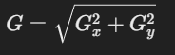
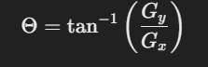
Mathematical Formulation
Gradient Magnitude Calculation:
Gradient Direction Calculation:

Slide 16
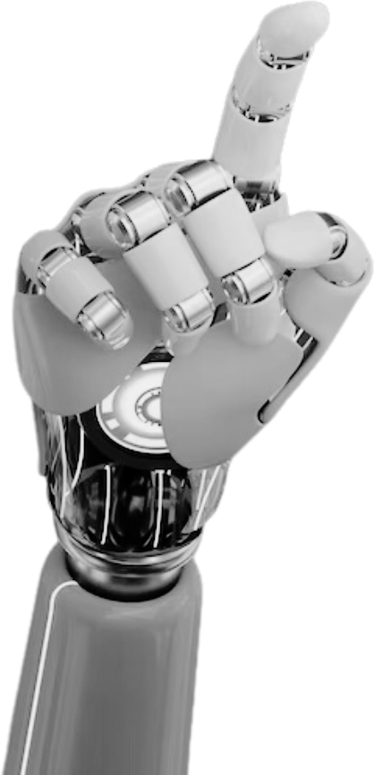

HSV COLOR THRESHOLDING
Segments objects based on color in the HSV space.
Separates color (hue) from brightness (value).
Useful for object detection in varying lighting conditions.

Slide 17
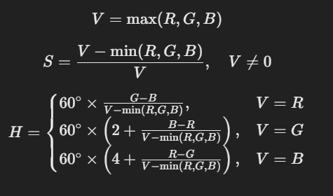
Mathematical Representation:
RGB to HSV conversion equations:

Slide 18
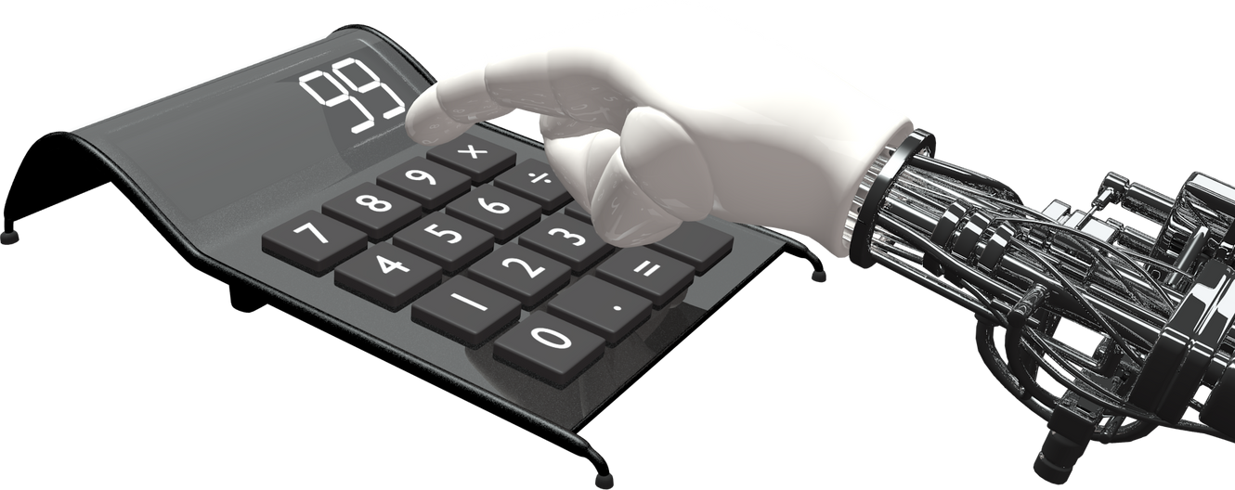
HOUGH TRANSFORM
Detects geometric shapes like circles and lines.
Uses an accumulator matrix for voting.
Robust against noise and partial shapes.

Slide 19
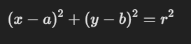
Mathematical Formulation
For circle detection in an image:
Where:
(a,b) = center of the detected circle
r = radius of the circle

Slide 20
INVERSE KINEMATICS
Computes joint angles to position robotic arms accurately.
Uses trigonometry and matrix transformations.
Essential in robotics for precise movement.

Slide 21
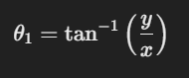
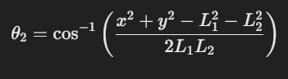
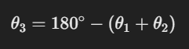
Mathematical Formulation
Compute the First Joint Angle θ1
Compute the Second Joint Angle θ2
Compute the Third Joint Angle θ3

Slide 22
PID CONTROL ALGORITHM
Controls motor movement smoothly and precisely.
Uses Proportional (P), Integral (I), and Derivative (D) components.
Prevents overshooting and stabilizes robotic movement.

Slide 23
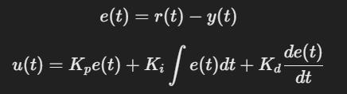

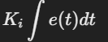
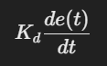
Mathematical Formulation
PID Components:
Proportional Term (P):
Integral Term (I):
Derivative Term (D):

Slide 24
Phases | Tasks | Timeline
Phase 1 | Research & Literature Review | Feb 1st Week
Phase 2 | Hardware & Software Setup OpenCV Object Detection Setup | Feb 3rd Week
Phase 3 | Servo Motor Integration & Control Robotic Arm Assembly & Testing | Mar 1st Week
Phase 4 | Communication Between OpenCV & Arduino Testing & Debugging | Mar 2nd Week
Phase 5 | Final Integration & Report Preparation | Mar 3rd Week
Timeline of Project

Slide 25
THANK YOU

